Slide 1
2022 Content Marketing Plan

Slide 2
In 2022, we will endeavour to create a solid content plan throughout the year, with a focus on major monthly campaigns, and smaller mini campaigns.
The campaigns will be split out amongst certain team members, with guidance and input from the rest of the team. The campaigns will have a central tagline or artwork to be used across all channels.
The major campaigns will be present across all of See Tickets channels, including social, email and web. We will aim to reach as wide an audience as possible, with the theme of the campaign being fairly generic or having widespread appeal.
Examples of these campaigns include:
The mini campaigns will include less activity than the major campaigns and be more targeted toward certain groups of customers, rather than a wide audience. We will focus more on pushing engaging content, such as blogs and social content, rather than sales in these.
Examples of these campaigns include:
CONTENT MARKETING
Mother’s Day
Festivals
Father’s Day
Comedy
Christmas
The BRITs
International Women’s Day
Record Store Day
Grassroots & New Music
Bank Holidays

Slide 3
MAJOR CAMPAIGNS

Slide 4
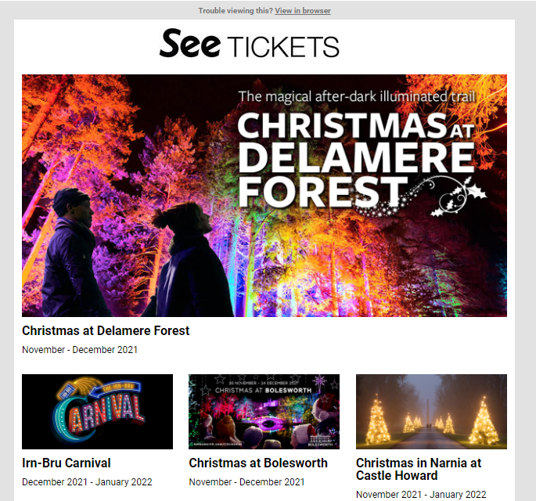
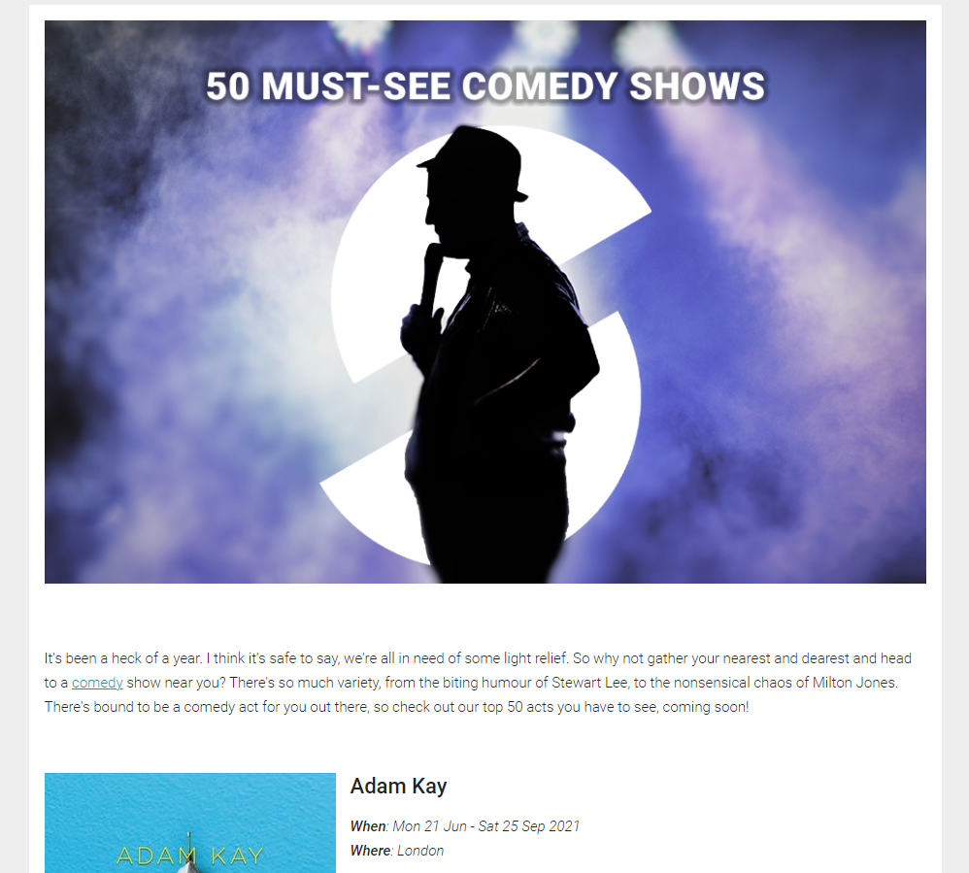
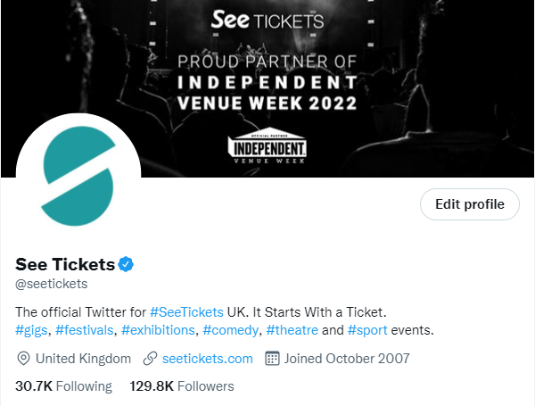
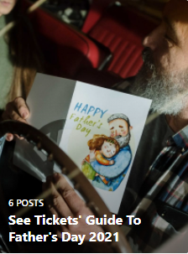
Activity included in each major campaign will include, as a minimum:
National Newsletter
MAJOR CAMPAIGNS
Highlights Blog
Social Takeover
Instagram Guides

Slide 5
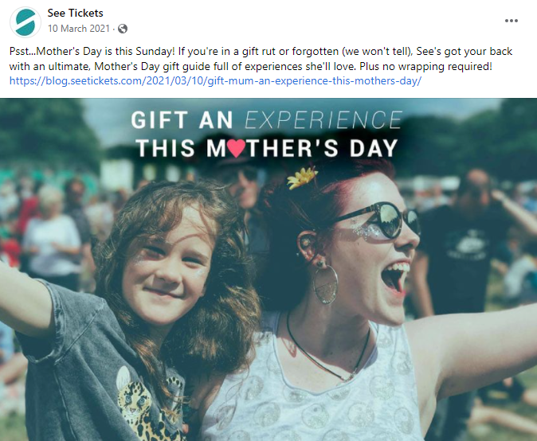
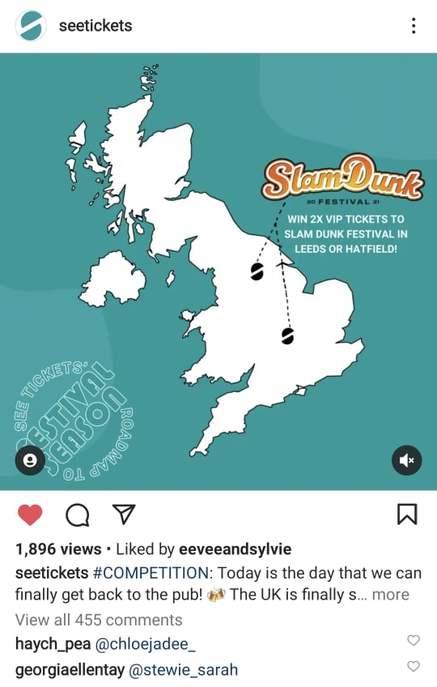
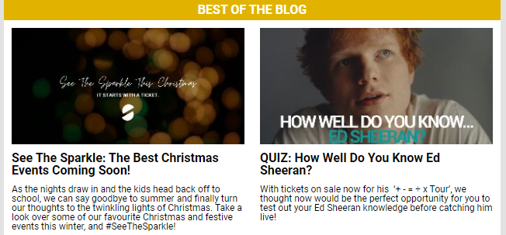
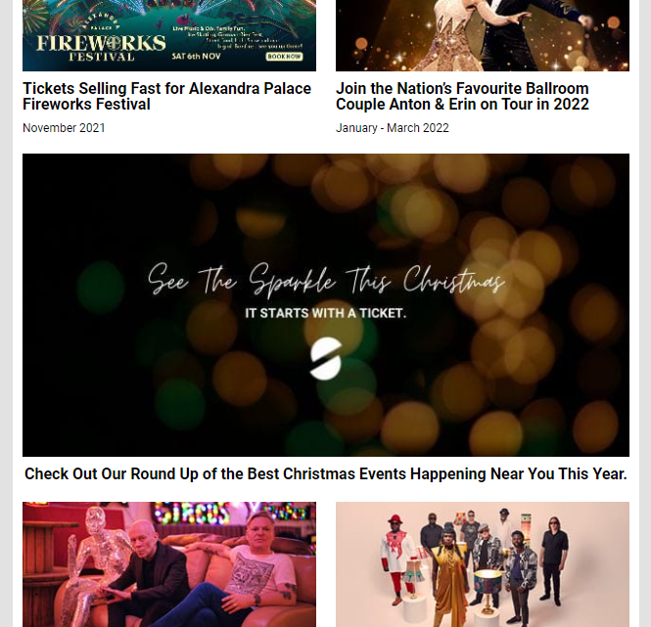
Activity included in each major campaign will include, as a minimum:
Social Coverage
MAJOR CAMPAIGNS
Competition
Weekly Blog Inclusion
Weekly Newsletter Spotlight

Slide 6
MINI CAMPAIGNS

Slide 7
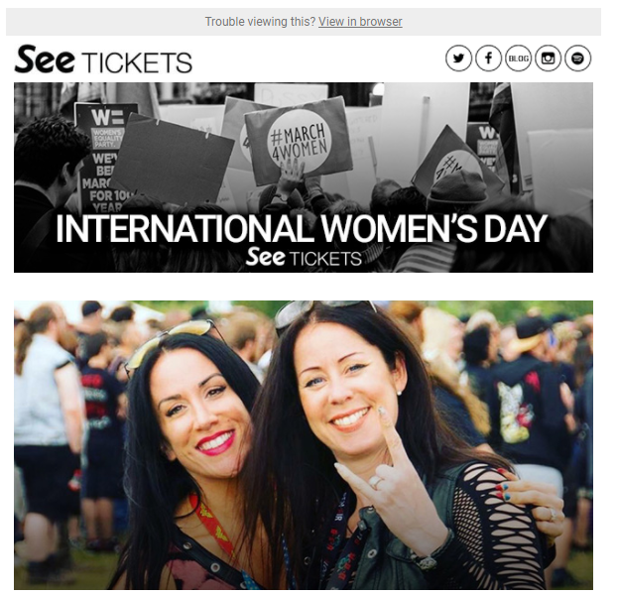
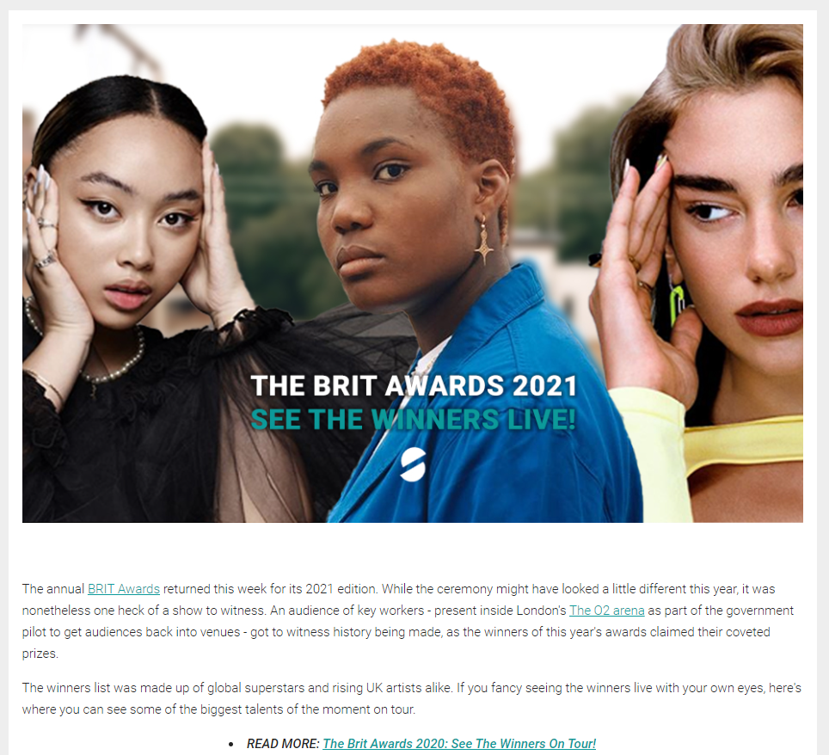
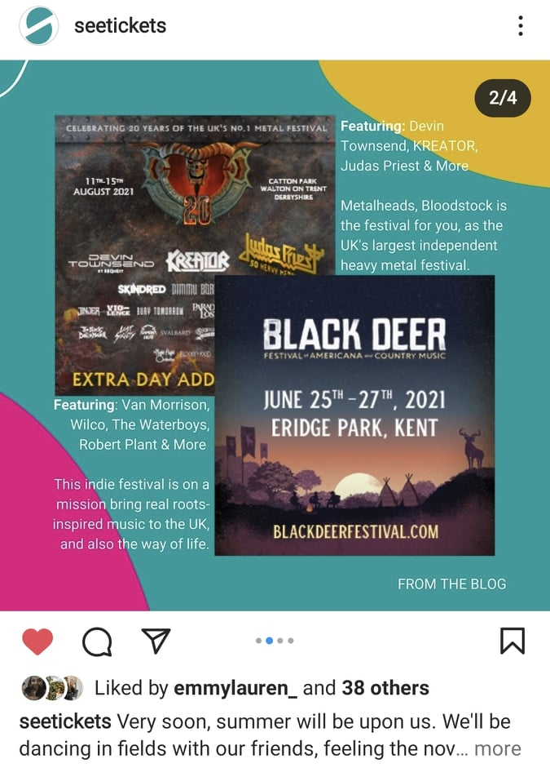
Activity included in each mini campaign will include, as a minimum:
Targeted Mailer
MINI CAMPAIGNS
Blog
Weekly Blog Inclusion
Instagram Zine

Slide 8
ARTWORK

Slide 9
Each Mini or Major Campaign will have central artwork in a variety of sizes.
Photoshop templates have been created so that the team can easily edit these sizes for each campaign. Safe zones will also be added so they can be made aware of any design restrictions when editing the artwork
Mailer Header
Blog Header
Social Sizes
640x200
940x600
1200x1200
828x315
1500x500
ARTWORK

Slide 10
SUGGESTED CAMPAIGNS

Slide 11
Subject to availability and other factors, here is the suggested campaigns we could run each month in 2022:
February
June
October
MAJOR: Mother’s Day
MINI: The BRIT Awards
MAJOR: Summer Holidays
MINI: Attractions
MAJOR: TBC
MINI: Halloween
SUGGESTED CAMPAIGNS
March
July
November
MAJOR: Festivals
MINI: International Women’s Day
MAJOR: Comedy
MINI: August Bank Holiday
MAJOR: Christmas Gifts
MINI: TBC
April
August
December
MAJOR: Outdoor Summer Shows
MINI: New Music & Grassroots Venues
MAJOR: Autumn Tours
MINI: TBC
MAJOR: TBC
MINI: New Year’s Eve
May
September
January
MAJOR: Father’s Day
MINI: Jubilee Bank Holiday
MAJOR: Christmas Events
MINI: TBC
MAJOR: 100 Gigs in 2023
MINI: TBC

